Slide 1
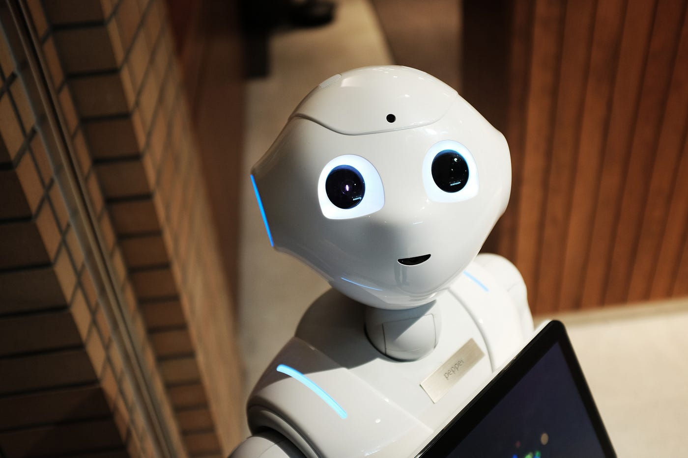
Developing A voice Assistant
FR
FABRIKAM RESIDENCES

Slide 2
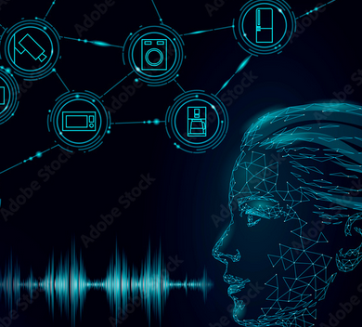
About The Project
Developing A voice Assistant
Our project aims to develop a voice assistant that can perform various tasks such as setting reminders, playing music, and answering questions
In this presentation, we will discuss the project's objectives, the technology behind it, the development process, and the final product

Slide 3
Technology Overview
The voice assistant is developed using machine learning algorithms, natural language processing (NLP), and speech recognition technology.
The project uses Python programming language and popular machine learning frameworks such as Tensor Flow and Keras.
We also used speech recognition libraries such as Google Speech Recognition and PyAudio to recognize the user's voice commands

Slide 4
Requirements of python libraries
The project was developed using an iterative approach, where we use pyttsx3 , Google Speech_recognition , Wikipedia, webbrowser and improved the voice assistant's functionality and user experience.
Code file :

Slide 5
pyttsx3
Pyttsx3 is a Python library that provides a cross-platform text-to-speech (TTS) conversion engine. It allows developers to easily integrate TTS functionality into their Python applications. Pyttsx3 uses the native text-to-speech engines of the operating system it's running on, making it an ideal choice for platform-independent TTS applications.
Pyttsx3 supports several TTS engines, including SAPI5 on Windows, NSSpeechSynthesizer on macOS, and eSpeak on Linux. It also allows developers to customize the voice used for TTS and to control the speed and volume of the speech output.

Slide 6
speech_recognition
SpeechRecognition is a Python library that provides an easy-to-use interface to convert audio recordings into text data. It allows developers to integrate speech recognition functionality into their Python applications with just a few lines of code.
The library supports several speech recognition engines, including Google Speech Recognition, CMU Sphinx, and Microsoft Bing Voice Recognition. Developers can choose the engine that best suits their needs based on factors such as accuracy, speed, and cost.
SpeechRecognition provides several options to customize the speech recognition process, such as adjusting the audio file's energy threshold, adjusting the recognition engine's language model, and setting a timeout for the recognition process.

Slide 7
wikipedia python libries
Wikipedia-API: A Python wrapper for the Wikipedia API that allows developers to easily retrieve Wikipedia articles and related data, such as categories, sections, and links. It supports several languages and allows developers to perform advanced queries, such as searching for articles by category.

Slide 8
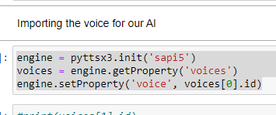
Python code overview
These lines of code initialize the pyttsx3 engine using the SAPI5 text-to-speech engine and retrieve the available voices.
The 1st line initializes the pyttsx3 engine with the 'sapi5' driver, which is the default text-to-speech engine on Windows.
The 2nd line retrieves the available voices for the engine. Each voice is represented as a “voice” object, which contains properties such as the voice ID, name, gender, age, and language.
The 3rd line sets the engine's voice property to the first voice in the list of available voices. This sets the default voice for the engine to the first voice in the list, which can be changed by setting the voice property to a different voice ID.

Slide 9
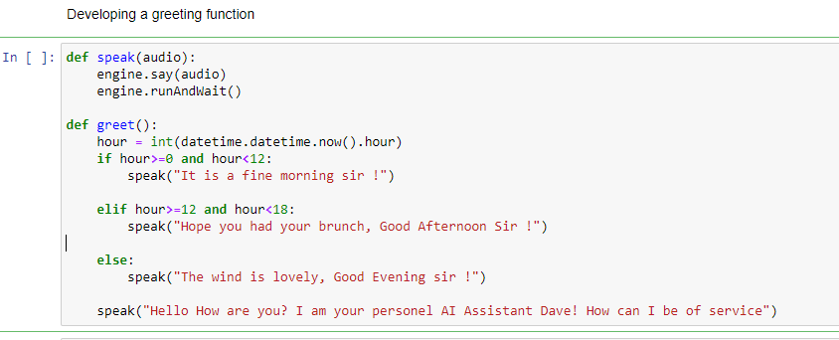
Python code overview
When you run the program, it should greet you based on the time of day and ask how it can be of service. You can then provide it with instructions, and it will respond appropriately using text-to-speech.
If you encounter any issues or errors, make sure that you have installed the “pyttsx3” library and that it is up to date. Additionally, make sure that your microphone and speakers are properly configured and that your volume is turned up.

Slide 10
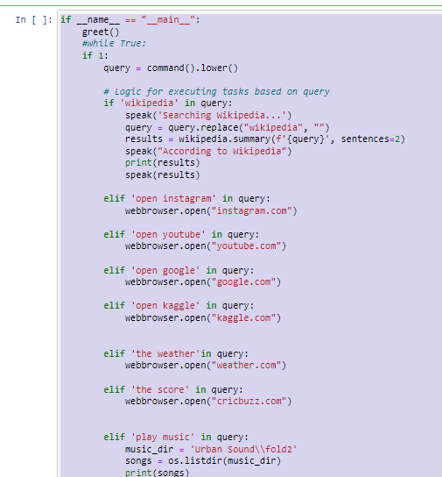
Python code overview
Once the user input has been converted into text, the code uses conditional statements to determine what action to take based on the user's input. For example, if the user says "play music", the program opens a directory containing music files and plays the first file in the directory. If the user says "open youtube", the program opens the YouTube website in a web browser.

Slide 11
Thank You.
FR
Goutam Das
FABRIKAM RESIDENCES
+91 9178982063
gdas22419@gmail.com
https://github.com/gdas22419

